Slide 1
Water Rights & Water Management Working Group Meeting #1
Tuesday, July 25, 2023
9:00 am – 11:00 am
Via Zoom

Slide 2
Welcome and Introductions Meeting Objectives
Review Working Group roles and responsibilities
Provide a recap of the June 21-22 Technical Briefings and relevant Planning Group discussions
Discuss Working Group objectives, potential work products, and timeline
Identify Working Group co-chairs in closed session

Slide 3
Welcome and Agenda Review
Time | Topic
9:00 am | Welcome, Introductions, and Agenda Review
9:15 am | Working Group Membership, Roles, and Responsibilities
9:30 am | Recap of Technical Briefings and Relevant Planning Group Discussions
9:45 am | Discussion of Working Group Objectives and Timeline
10:25 am | Recap of Discussion and Next Steps
10:30 am | Identification of Co-chairs (closed session)
11:00 am | Adjourn

Slide 4
Participation Guidelines
Working Group
Please be mutually respectful.
Actively listen.
One person speaks at a time.
Members of Public
Members of public are invited to observe.

Slide 5
Zoom Logistics
Working Group members and alternates please Rename yourselves in Zoom so that your name begins with “WG – ” (e.g., “WG – Mike Harty”).
Please virtually “raise your hand” to participate.
Please mute yourself when you are not speaking.
State your name and affiliation, then make your comment.
Facilitator will ensure that Working Group Members can participate fully.
Presentation, meeting notes, and recording will be available for public session items.

Slide 6
Zoom Instructions: How to Participate
Please use the chat only for technical assistance.

Slide 7
Working Group Membership, Roles, and Responsibilities

Slide 8
Working Group Membership and Participation
Working Groups participation open to all Planning Group members, alternates, and nominated technical experts.
Some portions of meetings will be open to public (as observers), some will be closed sessions.
Meeting schedule TBD, regular participation expected.
Working Groups will identify co-leads.

Slide 9
Planning Group Purpose
Seek to identify water supply resiliency solutions that respond to PG&E’s planned decommissioning of the PVP while protecting Tribal interests and supporting the stewardship of fisheries, water quality, and recreation in the Russian River and Eel River basins.

Slide 10
Working Group Roles & Responsibilities
Provide local expertise and knowledge of the Russian River and Eel River basins and the Potter Valley Project (PVP) and related water rights and water management issues, for informing the Water Forum planning process.
Jointly develop work products to support the Water Forum process
Provide input/feedback to the Planning Group on water rights and water management topics

Slide 11
Recap of Technical Briefings and Relevant Planning Group Discussions

Slide 12
Recap of Discussion Items from Technical Briefings and Planning Group Discussions
Water Rights & Water Management Technical Briefing June 22
Water Supply & Fisheries Technical Briefing June 21
Planning Group discussions
May 17: Discussion of Ad Hoc Committee and Two-Basin Partnership processes
June 12: Discussion of interests
July 13: Water resiliency presentations and discussion
Slides, water rights overview, recordings, and summaries posted on the RRWF website. (russianriverwaterforum.org)

Slide 13
Recap of Tech. Briefing and PG Discussion items
Water Rights & Water Management Technical Briefing topics:
Categories of water rights in the Russian River
Rights to “abandoned” PVP water
Rights to water stored in Lake Mendocino, including the “10,000 AFY reservation”
Potential effects of changes to the PVP
Water rights in the Eel River basin
Federal Indian reserved water rights
RVIT water and fishing rights in the Eel River basin

Slide 14
Recap of Tech. Briefing and PG Discussion Items
Municipal and agricultural water providers and water users in the Russian River Basin have implemented, and continue to implement, many measures to reduce water demand and increase water resiliency.
In the near term, eliminating the PVP diversion would result in water use curtailments and Lake Mendocino draining in 2 of 10 years.
In the long term, further resiliency investments could reduce or eliminate the need for the PVP diversion.

Slide 15
Recap of Tech. Briefing and PG Discussion Items
The Two-Basin Partnership (Round Valley Indian Tribes, CalTrout, Humboldt County, Mendocino IWPC, Sonoma Water) evaluated multiple scenarios for the future of the PVP.
The Partnership’s preferred alternative included:
Removal of Scott Dam
Improved fish passage* at Cape Horn Dam
Continued PVP diversion
* See next slide

Slide 16
Recap of Tech. Briefing and PG Discussion Items
Three alternatives for improved fish passage at Cape Horn Dam developed through the Ad Hoc Committee process are currently being assessed as part of DWR-funded study.
New Fish Ladder
Dam Removal with Pump Station
Dam Removal with Roughened Channel

Slide 17
Potential Information Needs Raised in Discussions
Water rights and water management needs raised in Technical Briefing and Planning Group discussions
Russian River: Joint memo on water rights issues, facts that aren’t in dispute
Documentation of Russian River water rights; Russian River water budget – documentation of water available and water used, data gaps
Information on Tribal water rights in both basins
Information on relevant federal reserved water rights

Slide 18
Discussion of Working Group Objectives and Timeline

Slide 19
Key Assumption for Discussing Options
In order to have a meaningful discussion of water rights and water management issues, an assumed scenario is needed.
Proposed: This Working Group proceeds under the assumption that a diversion will continue in some form, under the ownership of a new regional entity.
Is a discussion about this assumption needed?

Slide 20
Discussion Questions
How can this Working Group best support the goals of the Water Forum?
What should this Working Group discuss, what should it produce?
On what timeline?
Who will do the work?

Slide 21
Recap of Discussion and Next Steps

Slide 22
Next Steps and Future Meetings
Planning Group Meeting #4: Thursday, August 3, 10:00 a.m. – 3:00 p.m. (Ukiah/Hybrid)
Report-out from this Working Group meeting will be on agenda
Next Water Rights & Water Management Working Group Meeting: TBD

Slide 23
Identification of Working Group Co-Chairs [Closed session]

Slide 24
Proposed Co-Chair Responsibilities
Work with facilitation team to plan Working Group meeting agendas and coordinate with presenters
Support coordination/info sharing between Working Group and Planning Group, and across Working Groups
Participate in report-outs during Planning Group meetings
Communicate with Working Group members between meetings as needed
Co-chair responsibilities will be consistent across the Working Groups
The co-chairs are not expected to be decision-makers or to lead the Working Group meetings

Slide 25
Meeting is adjourned.
Thank you for attending!

Slide 26
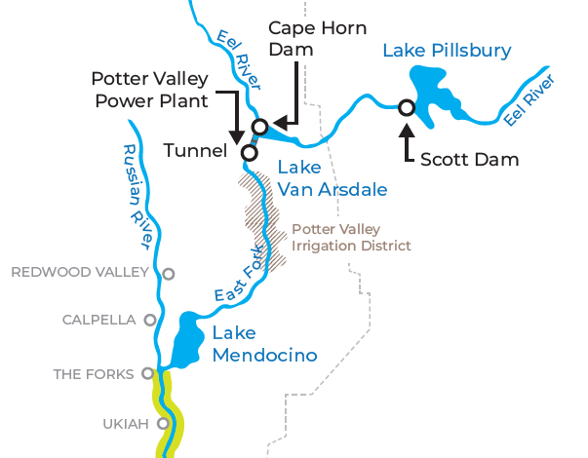
Potter Valley Project Area Map

Slide 27
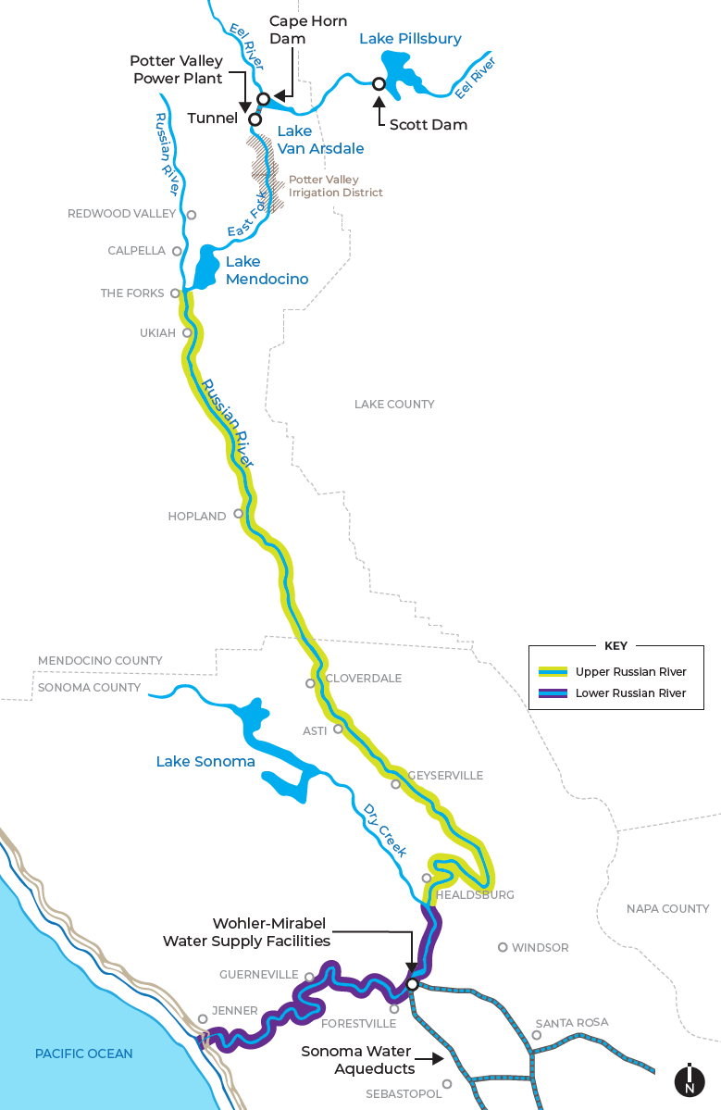

Slide 28
