Slide 1
Planning Group Meeting #6
Thursday, October 5, 2023
10:00 am – 1:00 pm
Zoom

Slide 2
Welcome and Introductions Meeting Objectives
Revisit outcomes from August 17 Planning Group meeting and follow up on action items and key discussion topics.
Provide update on New Eel-Russian Facility Proposal; discuss future coordination with Planning Group.
Provide updates on recent and upcoming Working Group meetings.
Provide presentation on Lake County and Lake Pillsbury Alliance interests in relation to Potter Valley Project and New Facility Proposal.
Provide the opportunity for public comment.

Slide 3
Welcome and Introductions Planning Group Member Introductions
Members, please introduce yourselves and state your affiliation.
E.g., Ben Gettleman, Kearns & West

Slide 4
Welcome and Agenda Review
Time | Topic
10:00 am | Welcome, Introductions, and Agenda Review
10:15 am | Outcomes and Follow-up from August 17 Planning Group Meeting
10:45 am | Update on New Eel-Russian Facility Proposal and Future Coordination with Planning Group
11:15 am | Update on Working Group Process and Upcoming Meetings
11:45 am | Lake County and Lake Pillsbury Alliance Presentations and Discussion
12:30 pm | Public Comment
1:00 pm | Adjourn; the room will remain open until 2:00 pm for optional networking time.

Slide 5
Planning Group Purpose
Seek to identify water supply resiliency solutions that respond to PG&E’s planned decommissioning of the PVP while protecting Tribal interests and supporting the stewardship of fisheries, water quality, and recreation in the Russian River and Eel River basins.

Slide 6
Participation Guidelines
Planning Group
Please be mutually respectful.
Actively listen.
One person speaks at a time.
One Planning Group member may participate per slot at a time (member or alternate).
Members of Public
Members of public are invited to share input during public comment.

Slide 7
Room & Zoom Logistics
To ensure a smooth hybrid meeting, please speak clearly and directly into the microphone, holding the microphone in front of your mouth.
If participating in person, please turn your table tent on its side if you would like to speak.
If participating virtually, please virtually “raise your hand” to participate.
Please mute yourself when you are not speaking.
State your name and affiliation, then make your comment.
Facilitator will ensure that virtual attendees can participate fully.
Presentation, meeting summary, and recording will be available.

Slide 8
Outcomes and Follow-up from August 17 Planning Group Meeting and September 15 Steering Committee Meeting

Slide 9
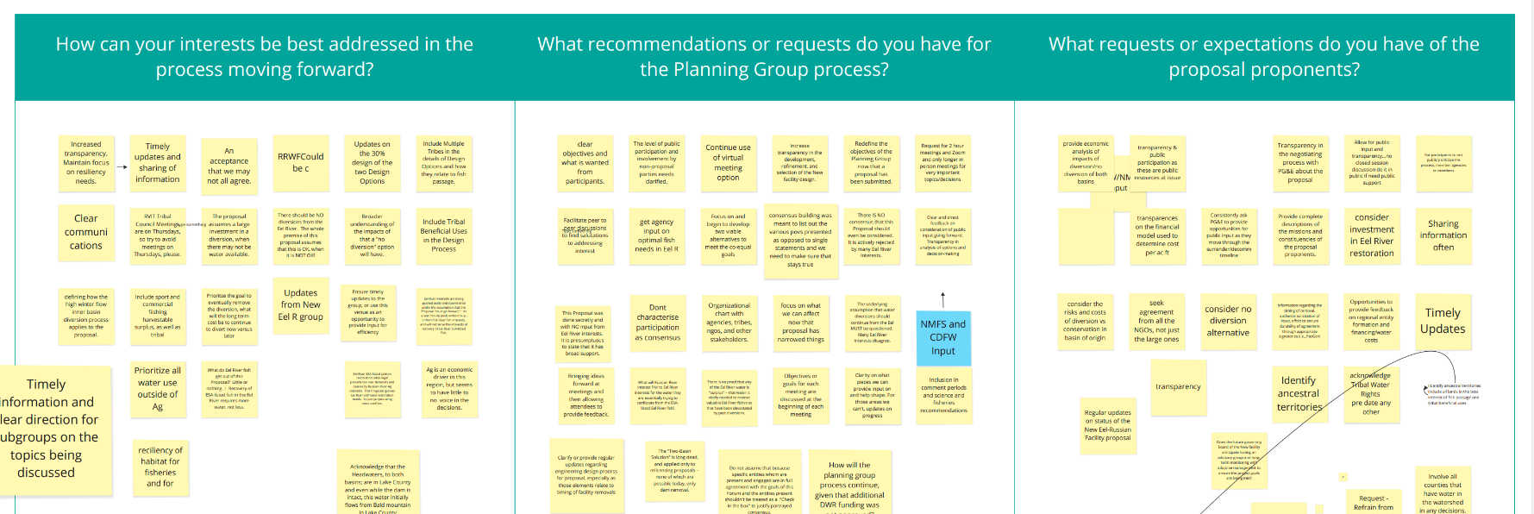
August 17 Planning Group Meeting
Proponents of the New Eel-Russian Facility Proposal to PG&E – IWPC, RVIT, and Sonoma Water – presented on their proposal.
Group discussion on a Miro Board included:

Slide 10
August 17 Planning Group Meeting
Key Themes from Input
Transparent, collaborative process between the Planning Group and the proponents with timely updates, clear requests for information, and satisfaction of mutual interests.
Inclusion of tribal beneficial uses and increased tribal input.
Set objectives for each meeting and consider redefining the PG’s objectives since the proposal has been submitted.
Consideration of impacts to fisheries and habitats in the Eel River watershed, and investment to mitigate these impacts and restore the watershed.
Economic analysis of impacts to both basins, tribal governments, and Lake County.

Slide 11
August 17 Planning Group Meeting (cont.)
Concern around participation being misconstrued as consensus; suggestion that converging and diverging views be captured without implying agreement.
Update on Water Rights & Water Management Working Group and its proposed work product: a high-level slideshow summary of water rights implications in different scenarios.
Some members noted that tribal water use predates all legal water rights and that tribal water rights should therefore be included in the Working Group’s proceedings.
Public comment was received and documented.

Slide 12
Outcomes from September 15 Steering Committee
Discussed Planning Group work schedule and discussion topics, Oct. 5 Planning Group Meeting, Sept. 26 Resiliency Subcommittee Meeting
Recommended website update: make Working Group page more accessible
Recommended including learning segment in future Planning Group meetings. Planned and potential topics:
October: Lake County and Lake Pillsbury Alliance Interests
November: Eel River Watershed, Health, and Restoration
Other potential topics:
Tribal connection, present and historical, to Eel and Russian Rivers
Russian River ecosystem restoration and health
Question: What topics would Planning Group members like to add to future meeting agendas?

Slide 13
Update on New Eel-Russian Facility Proposal and Coordination with Planning Group
Sonoma Water, Mendocino IWPC, and Round Valley Indian Tribes

Slide 14
Lake County and Lake Pillsbury Alliance Presentations and Discussion

Slide 15
Update on Working Group Process and Upcoming Meetings

Slide 16
Working Group Updates Water Rights & Water Management Working Group
Second meeting held August 21
Third meeting held September 18
Upcoming meetings:
October 16, 12-1 p.m.
November 13, 12-1 p.m.

Slide 17
Working Group Updates Water Rights & Water Management Working Group
August 21 Meeting:
Clarified work product: Presentation (~20 slides) showing implications for major categories of water rights holders in Russian River and Eel River basins under two scenarios:
Run-of-the-river diversion
No diversion
Identified drafting team and core team of reviewers (following slide)

Slide 18
Working Group Updates Water Rights & Water Management Working Group
Drafting team
David Taber, Palomino Mutual Water Co. (Co-chair)
Phil Williams, Counsel to City of Ukiah (Co-chair)
Kristin Peer, Counsel to Sonoma Water
Core team (regularly reviews the work of the drafting team)
Nikcole Whipple, Save California Salmon
Brenda Tomaras, General Counsel to Lytton Rancheria
Matt Clifford, Trout Unlimited
Adriane Garayalde, Russian River Confluence
Thank you to Sam Boland-Brien, SWRCB, for technical guidance

Slide 19
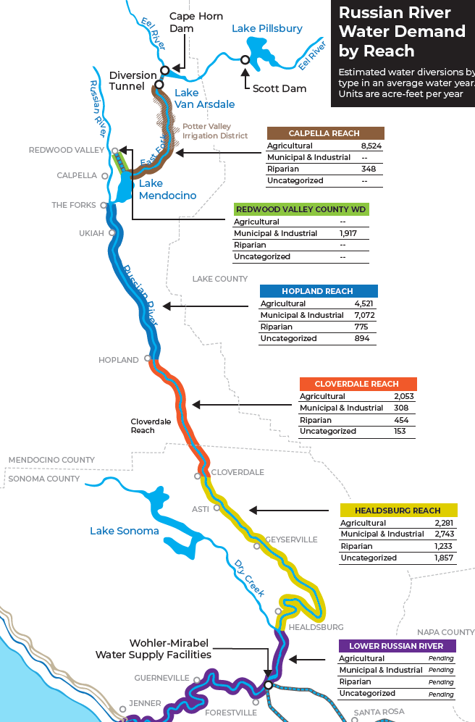
Working Group Updates Water Rights & Water Management WG
September 18 Meeting: Review of Work Product Outline
Context
Map of the system, scope of analysis, historical context
Tribal reserved water rights; in-stream flow requirements
Categories of water rights
“Colors” of water (natural flows, PVP water, Lake Mendocino storage)
Water demand by river reach (see map)
Scenarios: No diversion; run-of-the-river diversion
Assumptions regarding climate change
Impacts of both scenarios on major categories of water rights in the Eel River, Upper Russian River, and Lower Russian River

Slide 20
Working Group Updates Water Rights & Water Management Working Group
Deliverables/Review Schedule:
Oct. 16 Working Group meeting: Review of draft work product
Nov. 2 Planning Group meeting: Presentation of draft work product
Nov. 13 Working Group meeting: Review of revised/final work product

Slide 21
Working Group Updates Russian River Resiliency Subcommittee
Kick-off meeting held on September 26
Objectives:
Discuss vision for water resiliency in the Russian River basin
Discuss focus and potential work products for the Subcommittee
Select Subcommittee co-chairs
Group is compiling inventory of existing resiliency projects in watershed.
Elise Weiland (RR Confluence) presented; the Subcommittee is looking for ways to collaborate with and support Confluence’s work
Group identified co-chairs: Jaime Neary (Russian Riverkeeper), Jay Jasperse (Sonoma Water), and Adam Gaska (Redwood Valley CWD)
Next meeting: TBD

Slide 22
Working Group Updates Russian River Resiliency Subcommittee
Vision: sustainable, healthy ecosystem; reliable water supply; equitable, efficient distribution of water; effective metering and monitoring; beyond resiliency → proactive approach
Challenges: data availability; funding; water demand exceeds supply; lack of cross-jurisdiction coordination; complicated water rights and weak enforcement
Potential Role: forum for information sharing, education, and collaboration on regional and basin-wide solutions; pursue funding

Slide 23
Public Comment

Slide 24
Instructions for Public Comment
We will take in-person comments first, in order of the speaker cards we received, followed by Zoom comments.
We will call three people at a time. When you hear your name, please come to the microphone and line up if you are able.
To comment virtually, please use the “raise hand” function.
Each speaker will have 90 seconds to provide their comments.
The facilitation team will not be responding to comments at this time. Comments will be captured in the meeting summary.

Slide 25
Recap of Meeting and Next Steps

Slide 26
Next Steps and Future Meetings
Meeting Recap
Planning Group Meeting #7: Thursday, November 2, 10:00 a.m. – 1:00 p.m. (Ukiah/Hybrid)
Learning Topic: Eel River Watershed
Working Group Report-Outs
Recurring Planning Group Meetings: First Thursdays, 10:00 a.m. – 1:00 p.m. (Hybrid)
Meeting #8: Thursday, December 7
Meeting #9: Thursday, January 11
Meeting #10: Thursday, February 8
Meeting #11: Thursday, March 7
Meeting #12: Thursday, April 4
Working Group Meetings
Water Rights & Water Management: Monday, October 16, 12:00 – 1:00 p.m.
Russian River Resiliency Subcommittee: TBD
Next Steering Committee Meeting: Friday, October 20, 9:00 a.m. – 11:00 a.m.

Slide 27
Meeting is adjourned.
Thank you for attending!

