Slide 1
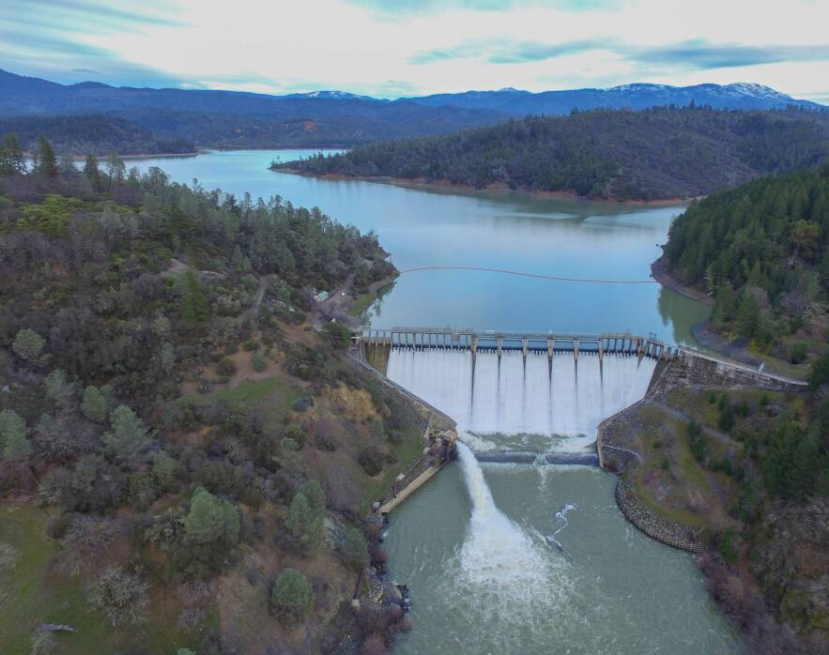
Lake Pillsbury
Interconnected

Slide 2
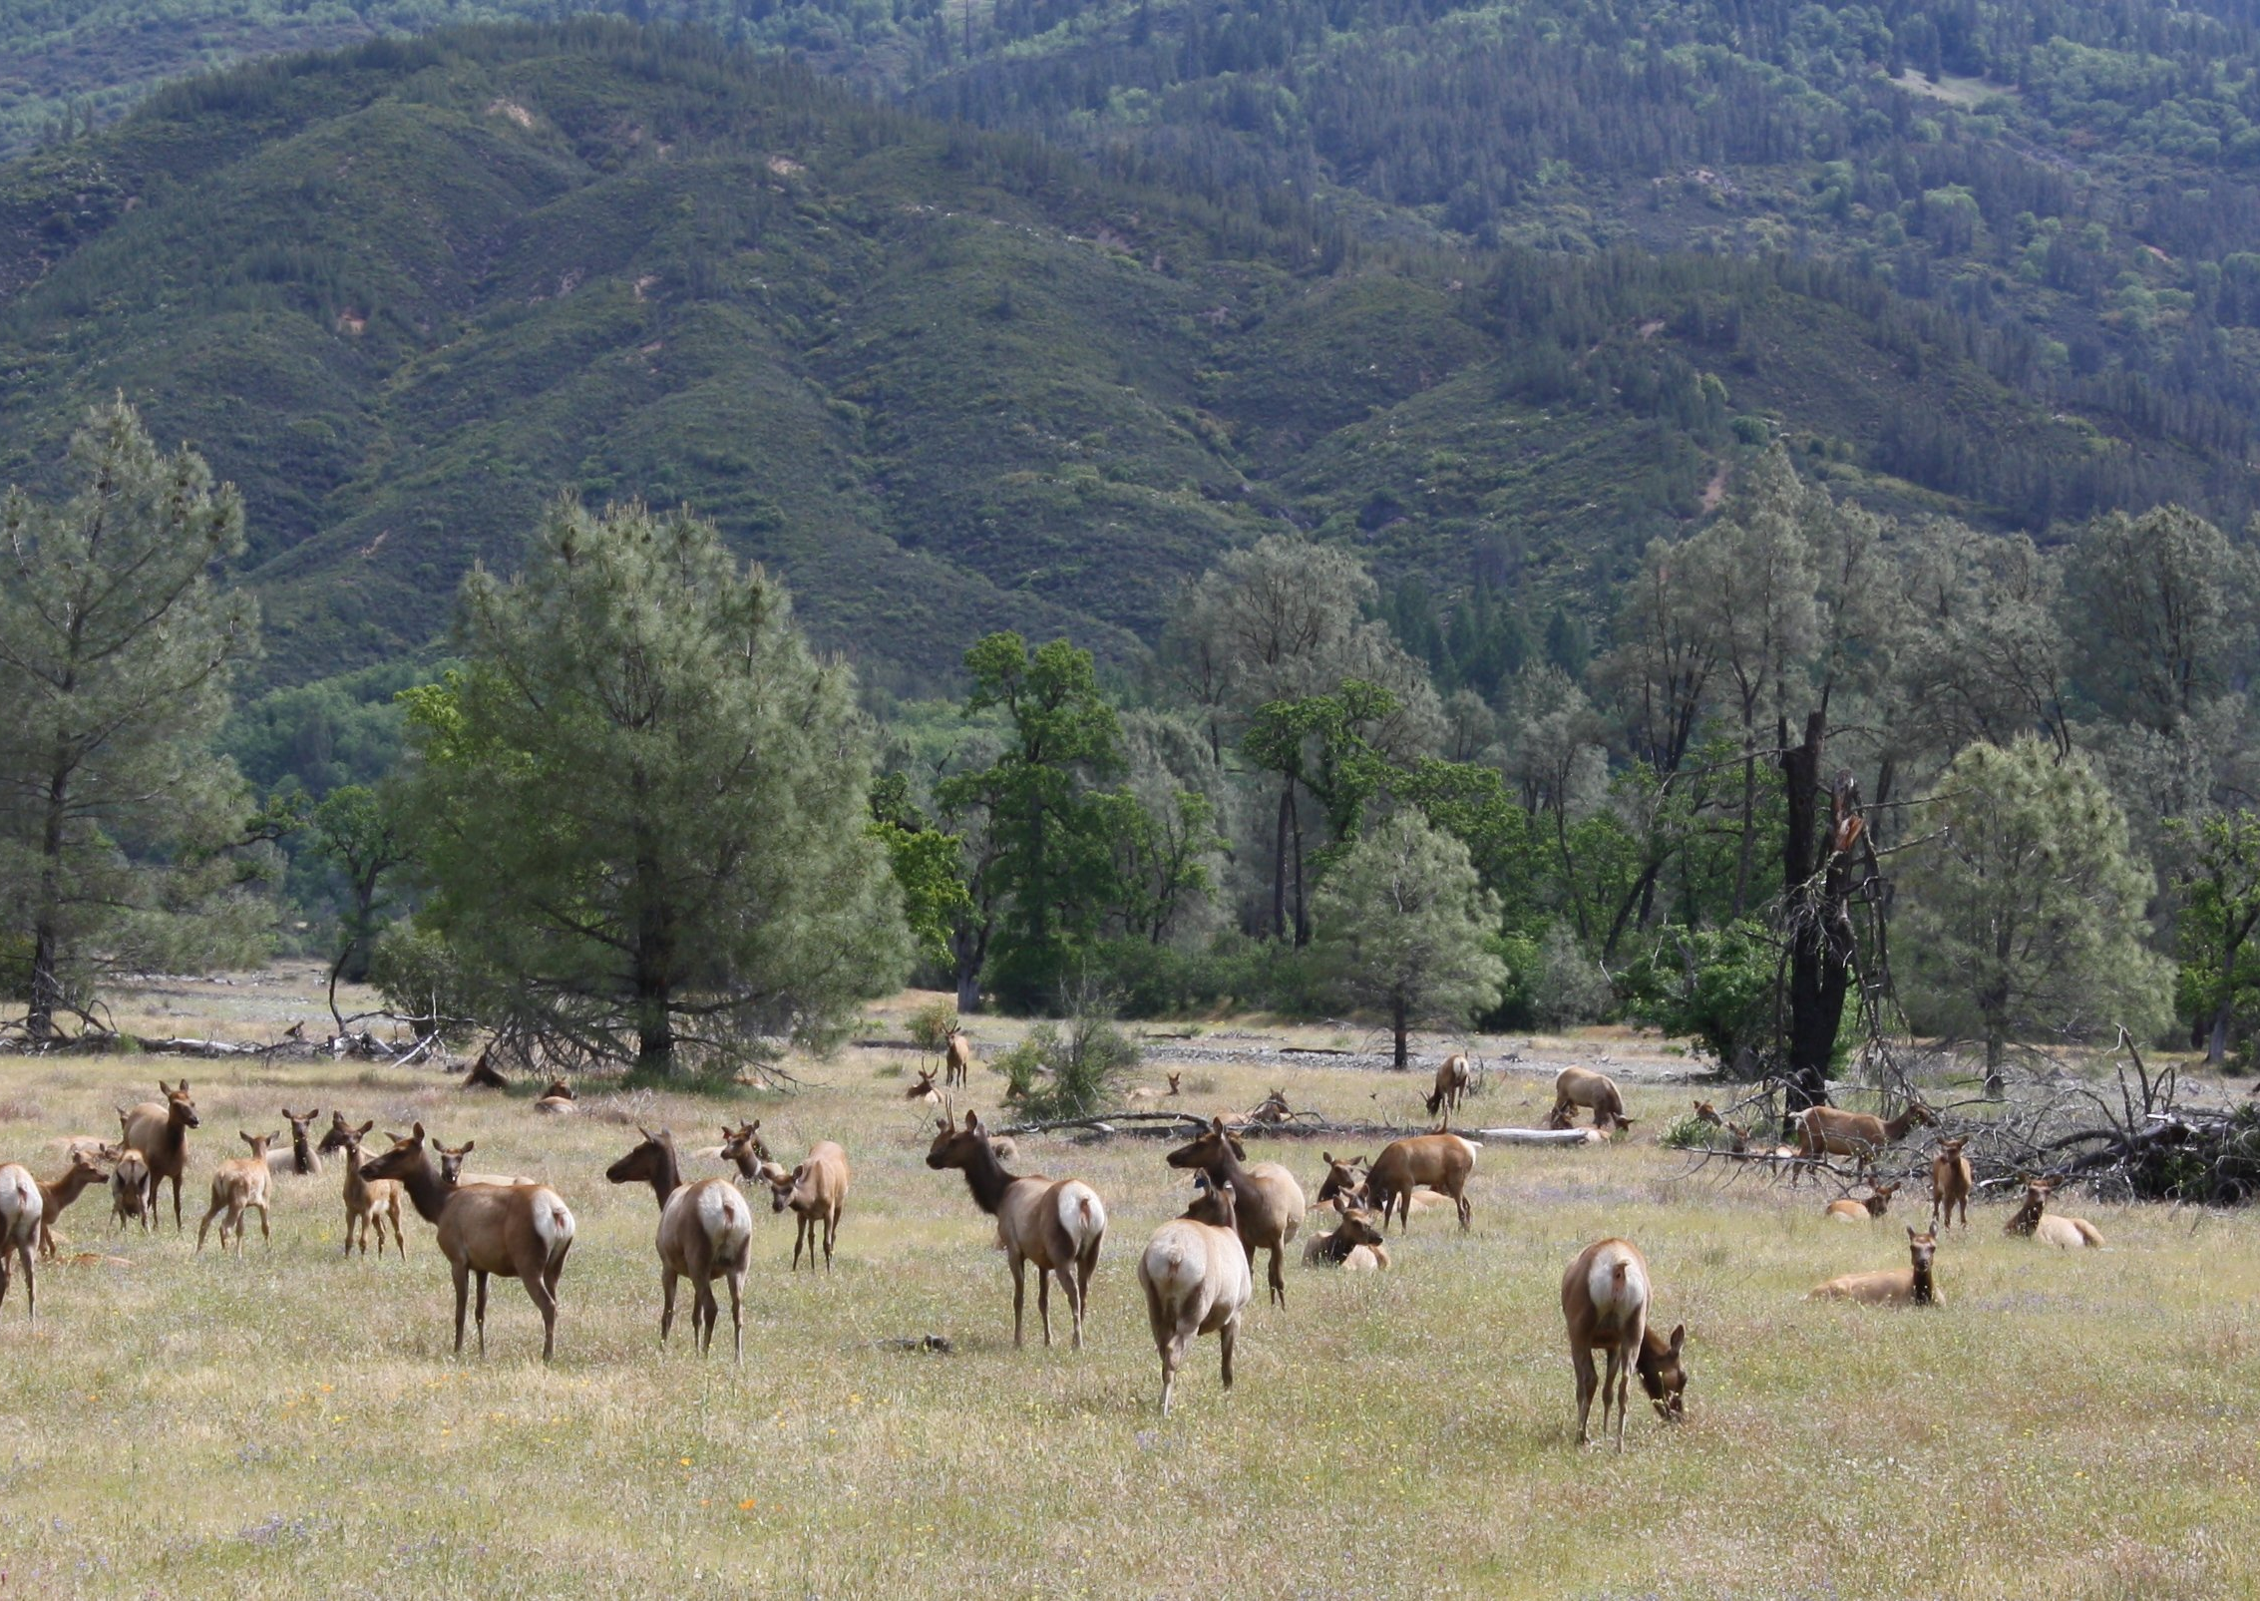
Lake Pillsbury
Ecology
Elk Herd
Fish
Birds
Economy
$750k in Lake County tax revenue
Lake County Destination
$40 million property value

Slide 3
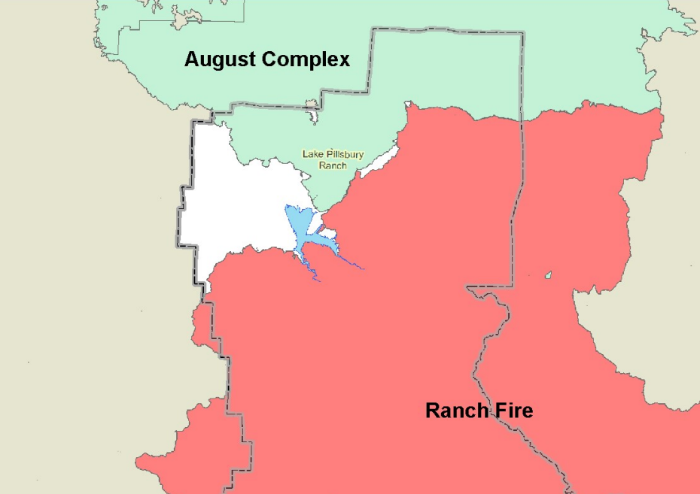
Lake Pillsbury
Fire Mitigation
Water Source for largest California fires
August Complex
#1 largest California fire
1,032,648 acres
Mendocino Complex
#3 largest California Fire
459,123 acres

Slide 4
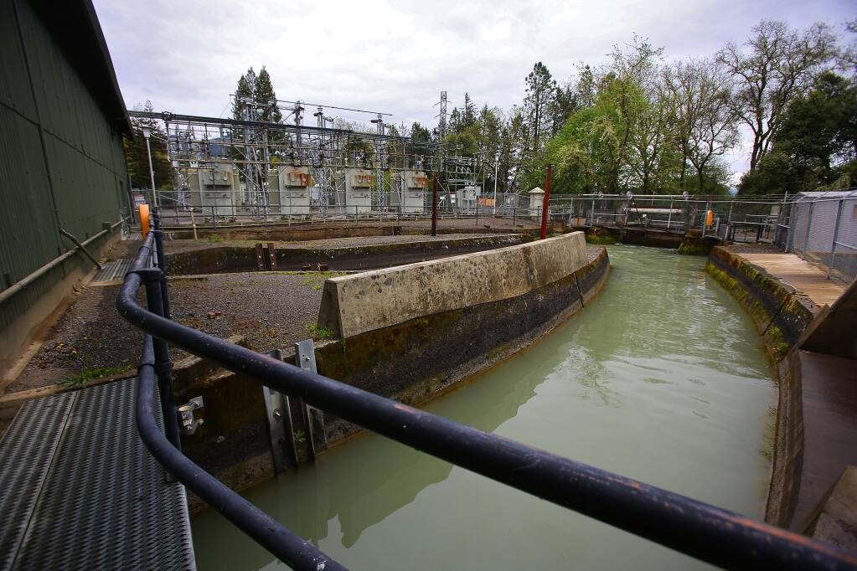
Lake Pillsbury
Water Source
Homeowners/Businesses
Well Access
Agriculture
Potter Valley Farms
Russian River Farms
Water Utility Districts
Sonoma Water
South to Marin County

Slide 5
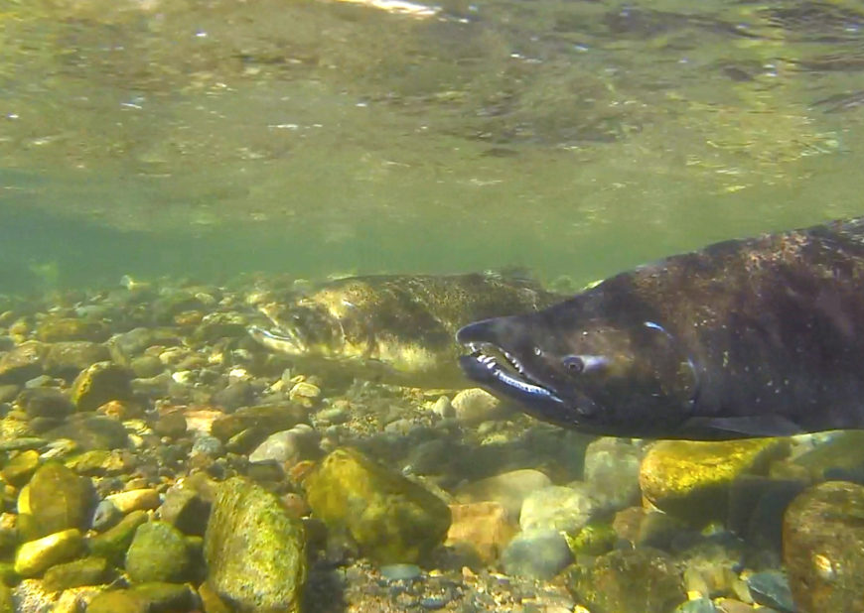
Lake Pillsbury
Fish
Van Arsdale Chinook Salmon
1947 – 1,000
1996 – 1,750
2012 - <3,500
Sacramento Pike Minnow
Cold Water
CalTrout FERC Request Letter

Slide 6
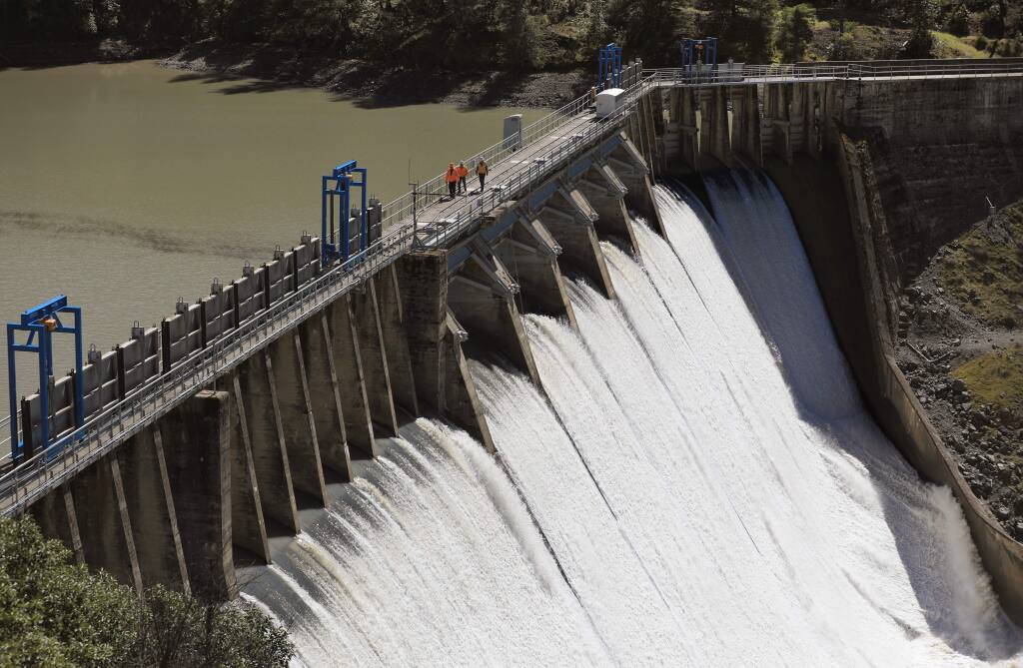
Lake Pillsbury
If Decommission Occurs
Economy
Tax Backfill
Economic Plan
Ecology
Full Restoration
Full Clean Up
Fire Mitigation
Water Source
Fish

Slide 7
Lake Pillsbury
Climate Change
Drought
No Water Inflow
Limited Diversion Flows
Drought Impacts
Prevents Greater Emergencies
Flood
No barrier storing water
Prevents greater emergencies
Fish
Ocean Issues
Water Levels

Slide 8
Lake Pillsbury
Cost Analysis
Keep Scott Dam
Known results
Assist with climate change
Doesn’t destroy communities
Does not require a new water storage
Decommission Scott Dam
Unknown results
Does not assist with climate change
Destroys community
Will require a new water storage

Slide 9
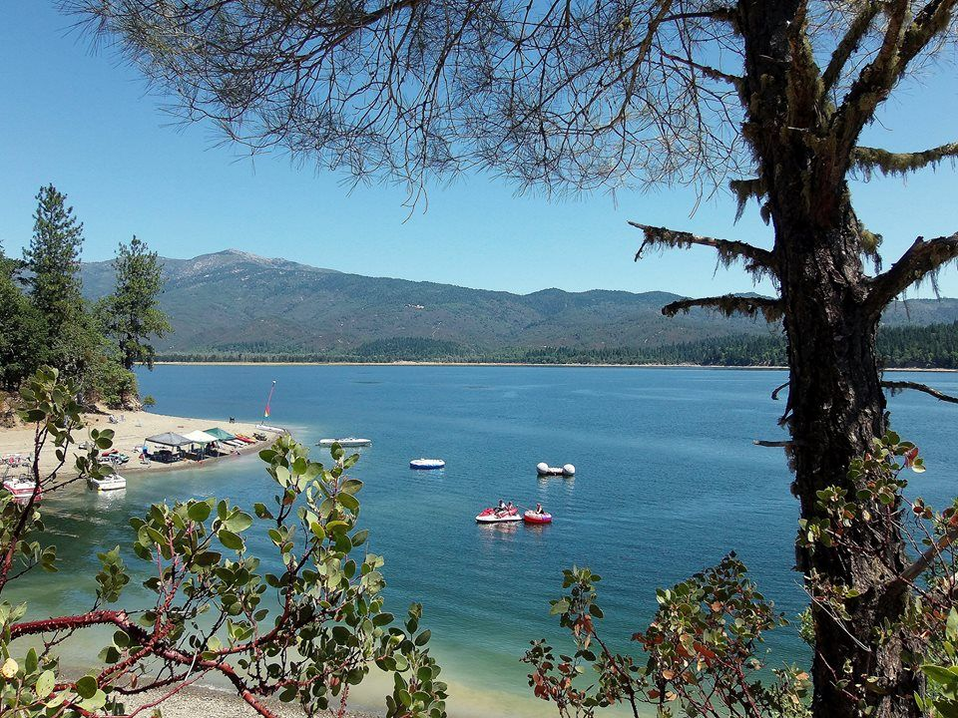
Lake Pillsbury
Why take the risk?
Save Lake Pillsbury
Save the Eel River
Save local agriculture
Save Water Utility Districts from reduced flows

